Slide 1
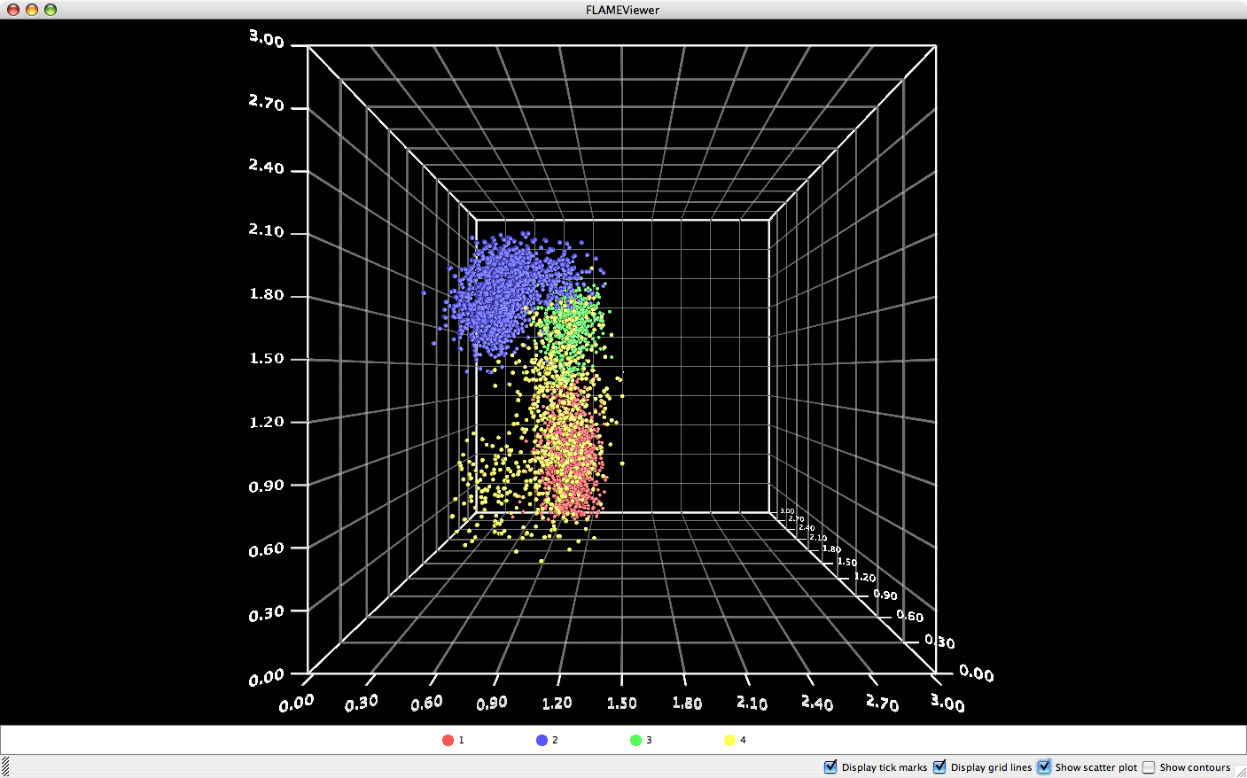
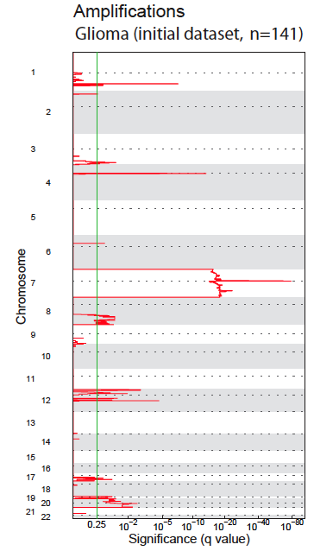
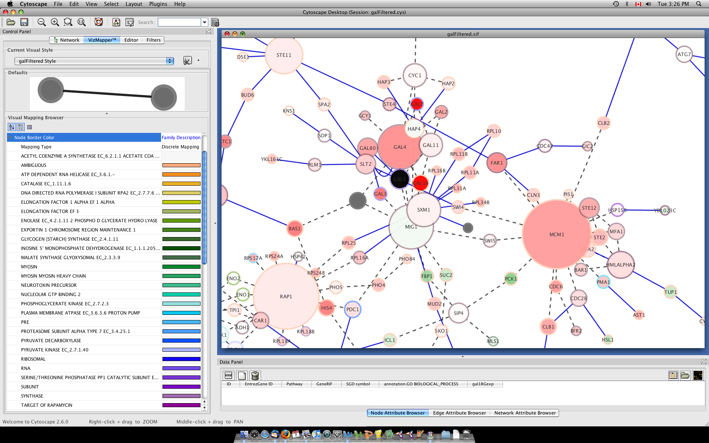
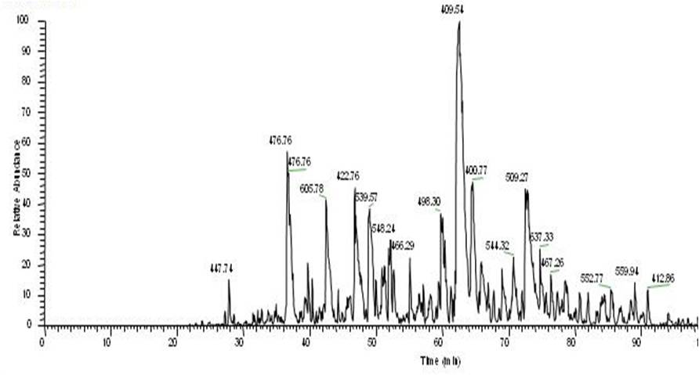
Other GenePattern Features
Sequence Variation
Analysis
Flow Cytometry
Network Analysis
Proteomics
Notes:
1

Slide 2

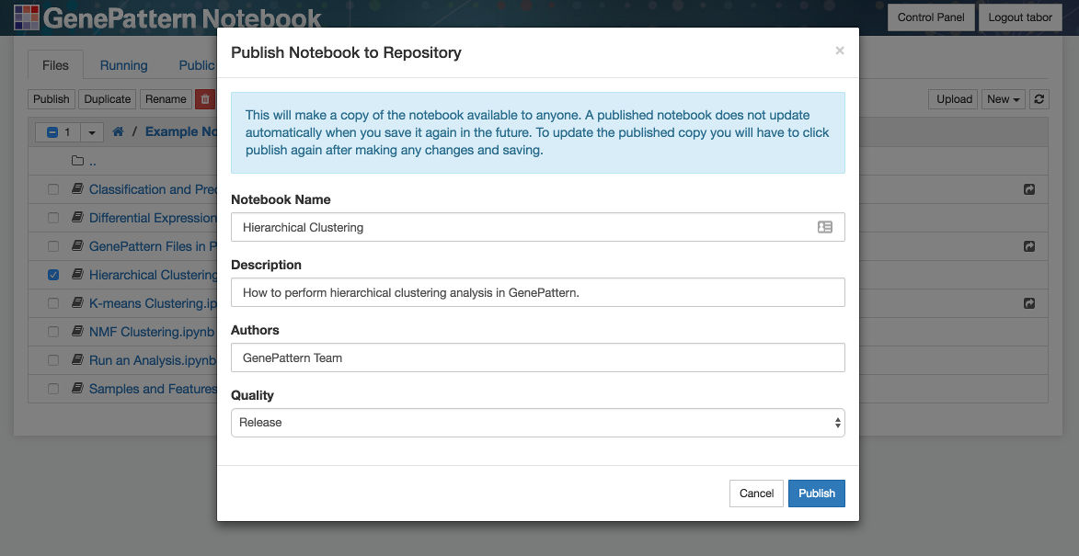
Publish Your Notebooks
Publish your own notebooks on the GenePattern Notebook Repository.
Share notebooks with others.
Notes:
Earlier we walked through browsing the list of available public notebooks.
.
The notebooks in this list were contributed by some combination of the GenePattern team and the GenePattern Notebook community.
.
In fact, anyone can share their own public notebooks in this way. This is a good way to share your research with others. It can be used to accompany a paper or other publication.

Slide 3
GenePattern Python Library
Control a GenePattern server via Python
Automatic integration with GenePattern cell data
import gp
# Create a GenePattern server proxy instance
gpserver = gp.GPServer('http://localhost:8080/gp','myusername', 'mypassword')
# Obtain GPTask by module name
module = gp.GPTask(gpserver, "PreprocessDataset")
# Load module parameter data
module.param_load()
# Create a job specification
job_spec = module.make_job_spec()
# Upload a file to the server
uploaded_file = gpserver.upload_file("file_name", "/path/to/the/file/file_name")
job_spec.set_parameter("input.filename", uploaded_file.get_url())
# Submit the job to the GenePattern server
job = gpserver.run_job(job_spec)
Notes:
Under the cover, all GenePattern cells use the GenePattern Library. This library allows a user to set analysis parameters, launch GenePattern jobs, retrieve the results and import the data in a way that can be used with other popular Python libraries.
.
For example, you can run an analysis in GenePattern, retrieve the results and then use that data with Python libraries such as matplotlib, scikit-learn or pandas.
.
That is, GenePattern doesn’t import any limitations on you. If you can write code, you can use the library to perform whatever analysis you want.
.
And here you can see a bit of example code up on the screen.

Slide 4
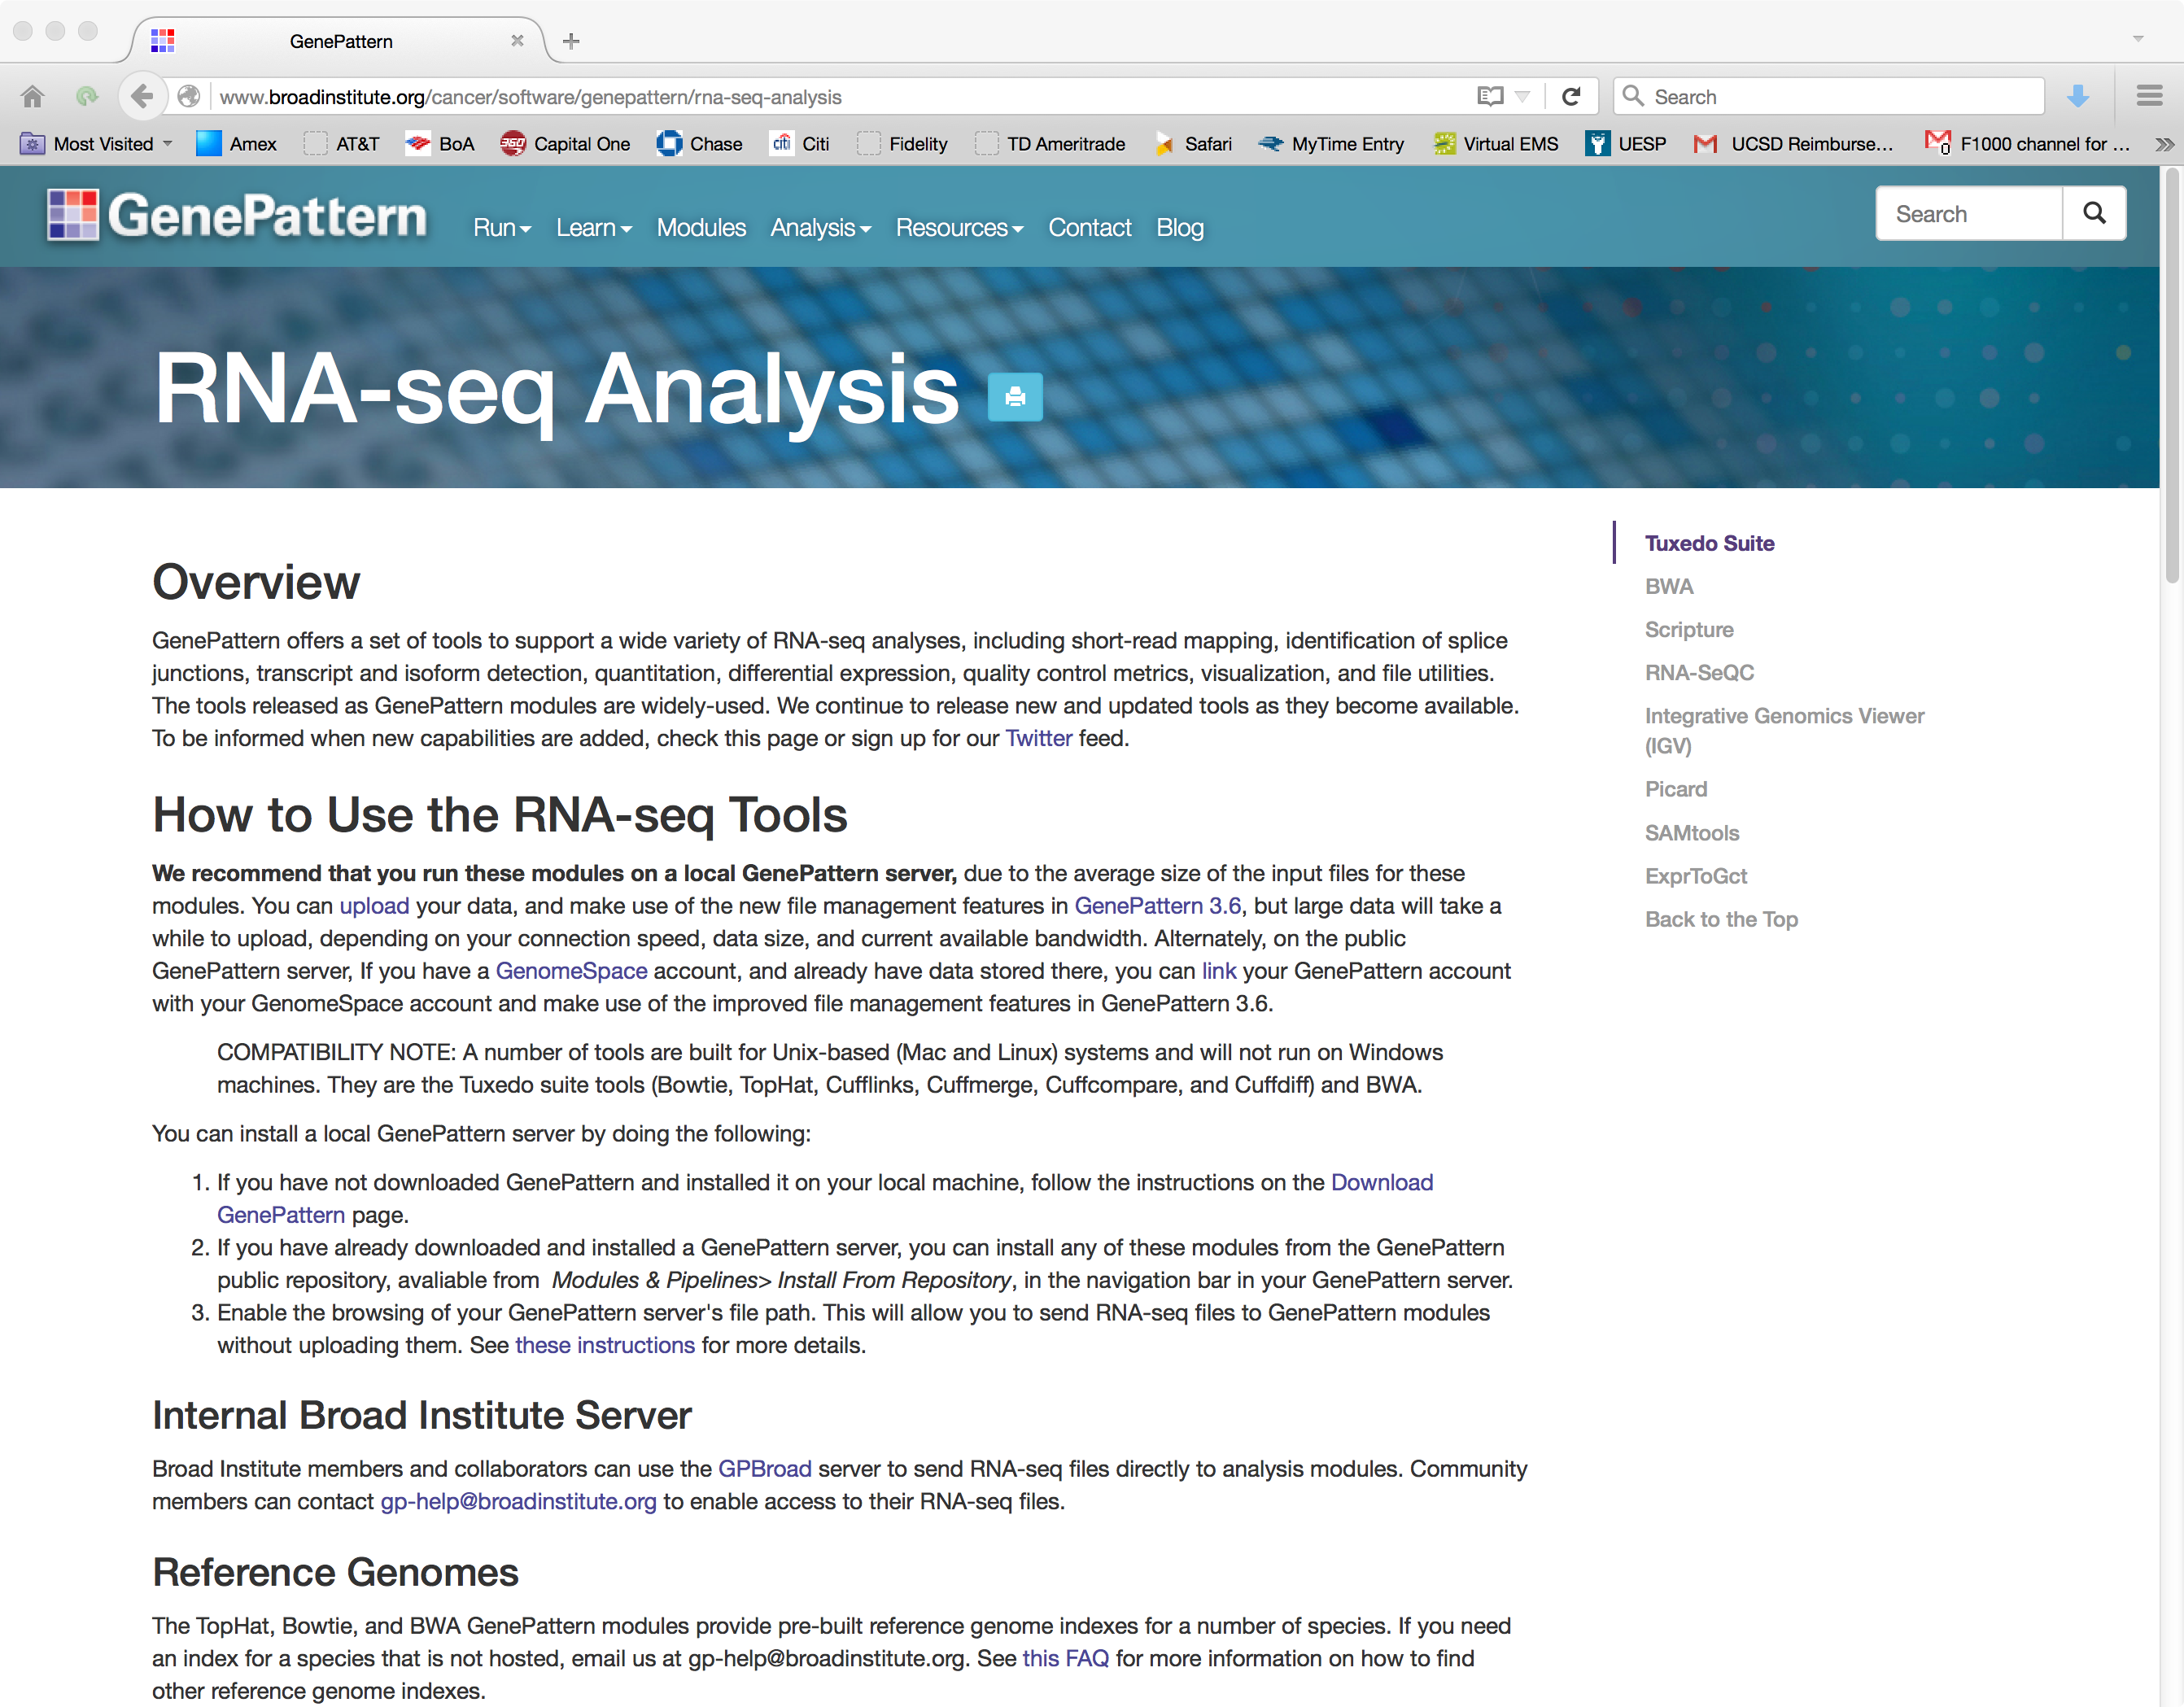
RNA-Seq in GenePattern
www.genepattern.org/rna-seq-analysis

Slide 5
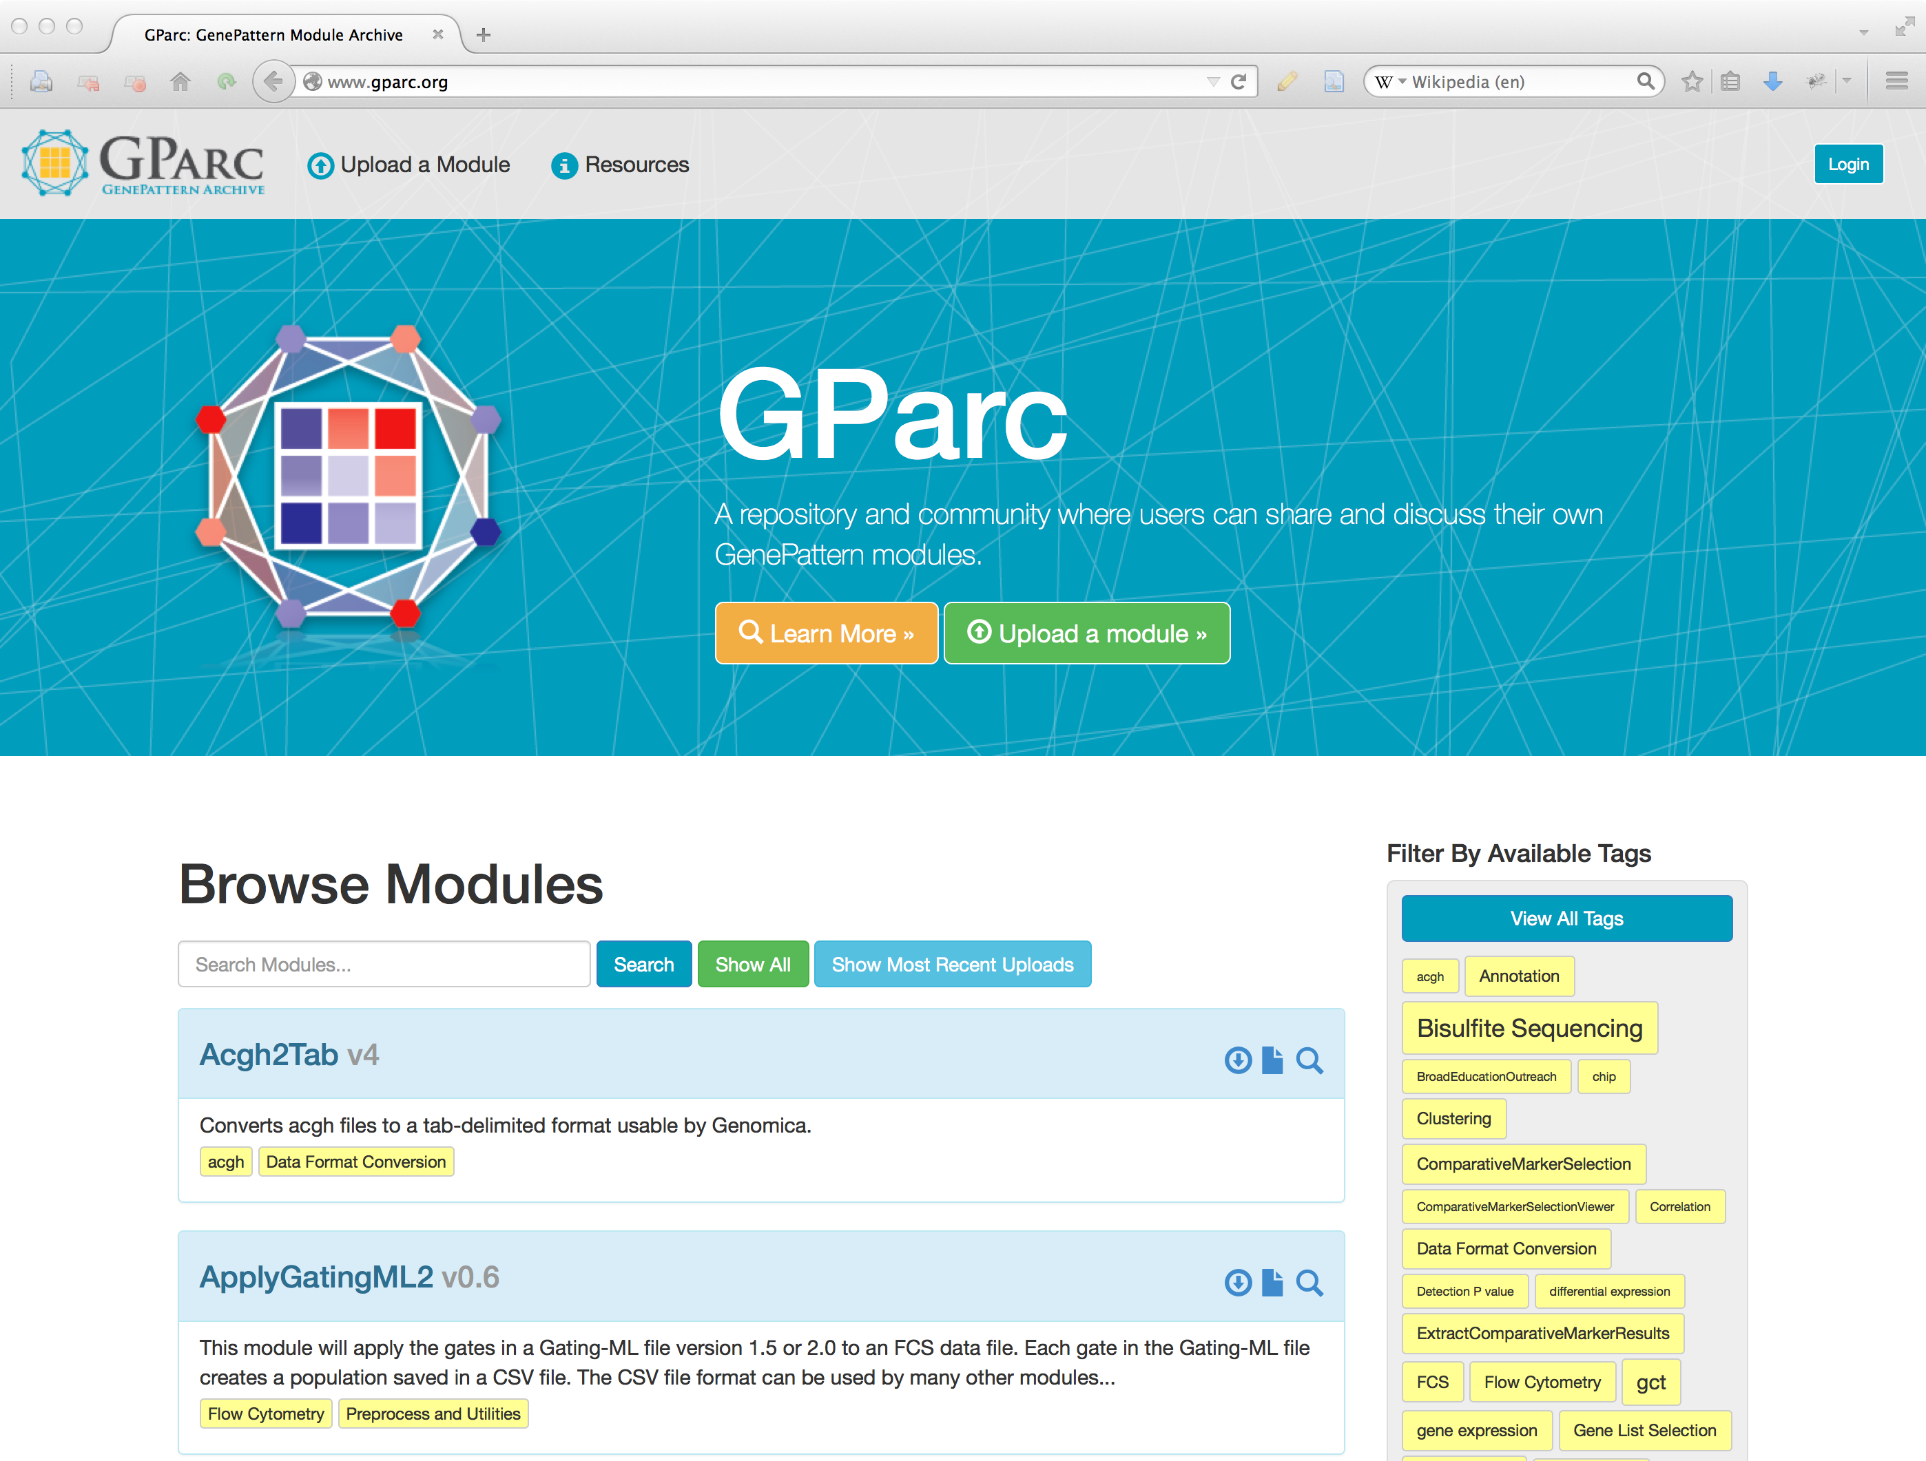
GParc: the GenePattern Archive
Find and download modules contributed by the worldwide GenePattern community
Share your own modules easily
Tag and comment on modules
Get module updates
www.gparc.org
Notes:
5

Slide 6
Resources
GenePattern
genepattern.org
Gene Set Enrichment Analysis (GSEA)
broadinstitute.org/gsea
GenomeSpace
genomespace.org
Public GenePattern server
genepattern.broadinstitute.org
Integrative Genomics Viewer (IGV)
www.igv.org
GenePattern Archive (GPArc)
gparc.org
GenePattern Notebook
www.genepattern-notebook.org

Slide 7

Keep in touch!
Feature requests, bug reports, and
general help use our online forum
https://groups.google.com/a/broadinstitute.org/forum/#!forum/gp-forum
Mailing list to receive GenePattern news.
Sign up at www.genepattern.org/gp_mail.html
Follow us on Twitter: @GenePattern

Slide 8
Our Team
Peter Carr – Cambridge, MA
David Eby - Japan
Barbara Hill – Cambridge, MA
Arthur Liberzon – Cambridge, MA
Ted Liefeld – San Diego, CA
Clarence Mah – San Diego, CA
Michael Reich – San Diego, CA
Jim Robinson – San Diego, CA
Thorin Tabor – San Diego, CA
Edwin Juarez – San Diego, CA
Pablo Tamayo – San Diego, CA
Helga Thorvaldsdottìr – Cambridge, MA
Douglass Turner – Cambridge, MA
PI
Jill P.Mesirov – San Diego, CA

Slide 9
